Slide 1
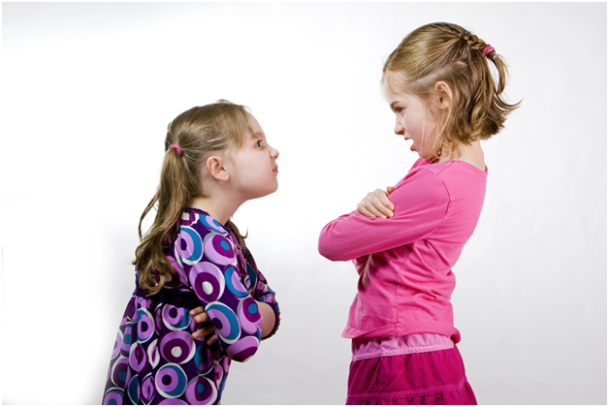
friendship & conflict
540 participants (only 112 were male)
all adults - 70% were aged between 18 & 38
363 were currently in a couple relationship
asked about ‘severe fallings out’ with people in their social network
last week/month/year
40% still not reconciled a year afterwards
conflicts with those who matter most to us in our personal social networks are surprisingly common
Dunbar, R. & A. Machin (2014). "Sex differences in relationship conflict and reconciliation." Journal of Evolutionary Psychology 12(2-4): 109-133.

Slide 2
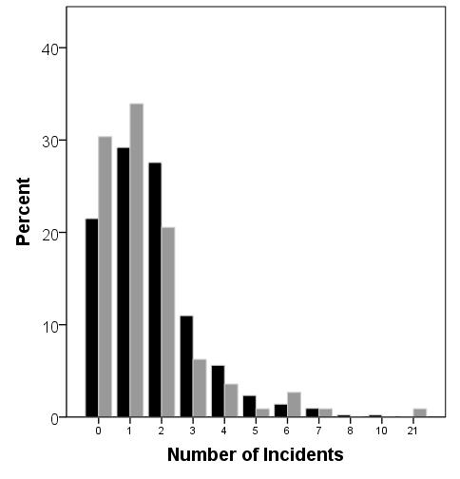
frequency of ‘severe falling out’
women: black columns
men: grey
columns
average of 1.67 episodes per person, but a high proportion were recent suggesting an underestimate for last year
Dunbar & Machin, 2014

