Slide 1
general orientation
work & S-DT needs – satisfaction & frustration both important
work-life balance – within three hours
VIA strengths use & job selection/crafting
Anders Ericsson’s ‘deliberate practice’

Slide 2
course outline/our journey
values, self-determination
mindset, exercise & sleep
willpower, diet, dependencies
mindbus & coping responses
savouring & gratitude
work, strengths, expertise
dunbar, roles, needs, dyads
nourishing, conflict, wisdom
groups, weak ties, resonance
review & stepping forward

Slide 3
work & s-dt needs satisfaction
“… all four satisfactions are significantly and independently associated with meaningful work.”
“ … the fulfilment of basic psycho-logical needs in the workplace is related to higher job satisfaction and … is associated with higher personal wellbeing & fewer health problems.”
how do you score on the work need satisfaction scale & any implications?
Martela, F. and T. J. J. Riekki (2018). "Autonomy, competence, relatedness, and beneficence: A multicultural comparison of the four pathways to meaningful work." Frontiers in Psychol 9(1157).
Gomez-Baya, D. and A. M. Lucia-Casademunt (2018). "A self-determination theory approach to health and well-being in the workplace.” J Appl Soc Psychol 48(5): 269-283.

Slide 4

work-life balance?
how many hours a week are you working at your job?
how many hours a week would you like to be working at your job?
3 hour or more difference weekly is associated with less life satisfaction
how do you score and is there anything it might be helpful to do about your current situation?
Headey, B. and R. Muffels (2018). "A theory of life satisfaction dynamics: stability, change and volatility in 25-year life trajectories in Germany." Social Indicators Research 140(2): 837-866.

Slide 5
2016 european positive psychology conference in angers, france
Harzer, C. and W. Ruch (2016). "Your Strengths are Calling: Preliminary Results of a Web-Based Strengths Intervention to Increase Calling." Journal of Happiness Studies 17(6): 2237-2256.
Harzer, C. (2016). “The eudaimonics of human strengths: The relations between character strengths and well-being.” Handbook of eudaimonic wellbeing. J. Vittersø. Berlin, Germany, Springer.
Harzer, C. and W. Ruch (2015). "The relationships of character strengths with coping, work-related stress, and job satisfaction." Front Psychol 6: 165.
Ruch, W., et al. (2014). "The Character Strengths Rating Form (CSRF): Development and initial assessment of a 24-item rating scale to assess character strengths." Personality and Individual Differences 68(Supplement C): 53-58.
Prof Willibald Ruch
University of Zurich

Slide 6
positive psychology conference

Slide 7
positive psychology conference

Slide 8
use of via (signature) strengths in job selection and job crafting
what are your ‘signature’ strengths (check with grid exercise)?
how much do you use these top strengths in your work – it may be worth charting on the weekly record
how could you increase your use of these strengths in your working life – job crafting & job selection?
www.viacharacter.org
Schutte, N. S. and J. M. Malouff (2019). "The Impact of Signature Character Strengths Interventions: A Meta-analysis.” Journal of Happiness Studies 20(4): 1179-1196.
Ghielen, S. T. S., et al. (2018). The Journa"Promoting positive outcomes through strengths interventions: A literature review.”l of Positive Psychology 13(6): 573-585.

Slide 9

ericsson & achieving excellence
Ericsson, K. A. (2017). "Expertise and individual differences: the search for the structure and acquisition of experts' superior performance.” Wiley Interdiscip Rev Cogn Sci 8(1-2).
Ericsson, K. A. (2015). "Acquisition and maintenance of medical expertise: a perspective from the expert-performance approach with deliberate practice." Acad Med 90(11): 1471-1486.
Hashimoto, D. A., et al. (2015). "Deliberate practice enhances quality of laparoscopic surgical performance in a randomized controlled trial: from arrested development to expert performance." Surg Endosc 29(11): 3154-3162.
Ericsson, K. A. (2013) “The science of excellence meets psychotherapy.” lecture at “Achieving clinical excellence conference” , May 17th, Amsterdam.
Ericsson, K. A., K. Nandagopal, et al. (2009). "Toward a science of exceptional achievement: Attaining superior performance through deliberate practice." Ann N Y Acad Sci 1172:199-217.
Ericsson, K. A. (2008). "Deliberate practice and acquisition of expert performance: A general overview." Acad Emerg Med 15(11): 988-994.
Ericsson, K. A., J. t. Whyte, et al. (2007). "Expert performance in nursing: Reviewing research on expertise in nursing within the framework of the expert-performance approach.“ ANS Adv Nurs Sci 30(1): E58-71.
Ericsson, K. A., M. J. Prietula, et al. (2007). "The making of an expert." Harv Bus Rev 85(7-8): 114-121, 193.
Ericsson, K. A. (2007). "An expert-performance perspective of research on medical expertise: The study of clinical performance." Med Educ 41(12): 1124-1130.
Notes:
Benor in his 1990 survey states that a he identified 131 controlled trials of spiritual healing in English of which 56 showed statistically significant results at p<.01 or better and another 10 at p<.02-.05. The studies involved healing effects on enzymes, cells, yeasts, bacteria, plants, animals and man.
The study published in Holistic Medicine describes the fascinating work on anaesthetized mice which amongst other things showed a “linger effect”.

Slide 10
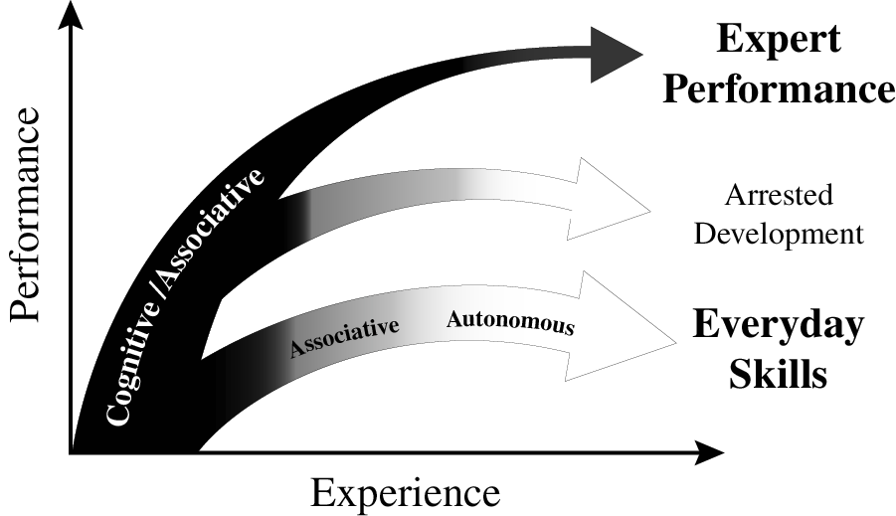
experience & variety of outcomes
Ericsson K. Anders. (2013). "The science of human excellence meets psychotherapy.” lecture at “Achieving clinical excellence conference.” May 17th, Amsterdam.

Slide 11

musicians & deliberate practice
classic early study on 20 yr old
violin students at the renowned
Music Academy of West Berlin
painstaking series of interviews
students sorted into 3 groups by professors’ assessments and success in open competitions
groups indistinguishable by average age of starting violin (age 8), average age at which decided to become musicians (just before age 15), number of teachers, etc. etc.
what stood out dramatically were the differences in hours spent practising – with no exceptions!
Ericsson, K. A., Krampe, R. T. & Tesch-Romer, C. (1993). “The role of deliberate practice in the acquisition of expert performance." Psychol Review 100(3): 363-406.

Slide 12
design & sequencing of training
ideally one monitors current performance & then designs specific individualized training activities: there is relevance here both for psychotherapists & clients.
Ericsson K. Anders. (2013). "The science of human excellence meets psychotherapy.” lecture at “Achieving clinical excellence conference.” May 17th, Amsterdam.

