Slide 1
general orientation
work & S-DT needs – satisfaction & frustration both important
work-life balance – within three hours
VIA strengths use & job selection/crafting
Anders Ericsson’s ‘deliberate practice’

Slide 2
course outline/our journey
values, self-determination
mindset, exercise & sleep
willpower, diet, dependencies
mindbus & coping responses
savouring & gratitude
work, strengths, expertise
dunbar, roles, needs, dyads
nourishing, conflict, wisdom
groups, weak ties, resonance
review & stepping forward

Slide 3
general orientation
fred bryant’s savouring: the ability to really appreciate good things
mihalyi csikszentmihalyi’s notion of flow states
barbara frederickson’s broaden & build theory of positive emotions

Slide 4
savouring, mindfulness & flow
focus on positive experiences in past, present or future
savouring
focus on the positive
deliberate, non-judgemental attention to what is happening in the present moment
full immersion in what one is doing with loss of self-consciousness
mindfulness
focus on the present
flow
focus on the activity

Slide 5
small is beautiful
subjects monitored for six weeks
reminder beeper
record kept of whether felt positive & if so how positive
overall happiness depends on how often we feel good
brief peaks are relatively unimportant
Larsen RJ, Diener E & Cropanzano RS Cognitive operations associated with
individual differences in affect intensity J Personal Soc Psychol 1987;53:767-74

Slide 6
effects of gratitude on wellbeing
3 research studies with a total of 314 participants
the first 2 studies involved students, the 3rd involved sufferers from a neuromuscular disease clinic
participants randomized to several different groups
the groups were each asked to record different things, for example personal hassles, experiences they were grateful for, social comparisons, and life events
groups were compared on several measures including mood, physical symptoms, relationships, life satisfaction

Slide 7
improved mood & enjoyment
remembering this exercise only took a very few minutes per day, the results were impressively worthwhile
participants asked to note experiences they were grateful for did better than the social comparisons group and much better than the noting hassles group
these benefits involved improvements over simply noting neutral life events in mood (9.8%), overall life satisfaction (13.8%), optimism about the future (5.4%), and feeling more connected with others (11.7%)
Emmons, R.A. & McCullough, M.E. Counting blessings versus burdens: an experimental investigation of gratitude and subjective well-being in daily life.
J Personal Soc Psychol 2003; 84(2): 377-389.

Slide 8
“coming to our senses”
a mindfulness/focus exercise for walking & ‘travelling’
1.) observing ... , observing ... , observing ...
2.) sensing ... , sensing ... , sensing ...
3.) hearing ... , hearing ... , hearing ...
... and keep re-cycling through this sequence
in ‘beautiful’ vision-rich environments, maybe use the ‘observing’ focus every second option
voir to see
Il s'agit de voir
Tellement plus clair,
De faire avec les choses
Comme la lumière
It’s a question of seeing
so much clearer
of doing to things
what light does to them
Eugene Guillevic Selected Poems translated by Denise Levertov

Slide 9
savouring, mindfulness & flow
focus on positive experiences in past, present or future
savouring
focus on the positive
deliberate, non-judgemental attention to what is happening in the present moment
full immersion in what one is doing with loss of self-consciousness
mindfulness
focus on the present
flow
focus on the activity

Slide 10
flow, enjoyment & increased ability
high
flow
channel
challenge and skills probably need to be greater than “normal” for greatest enjoyment, good focus & increased ability
anxiety
3
4
challenges
1
2
boredom
low
low
skills
high

Slide 11
general orientation
fred bryant’s savouring: the ability to really appreciate good things
mihalyi csikszentmihalyi’s notion of flow states
barbara frederickson’s broaden & build theory of positive emotions

Slide 12
positive emotions build resources
physical resources
social resources
speed recovery from stress,
promote fitness, boost
immunity, reduce mortality
build relationships
encourage empathy,
connections & support
intellectual resources
psychological resources
broaden attention focus
promote flexibility, intuition,
& creative problem-solving
increase happiness,
promote resilience to stress
& psychological growth

Slide 13
‘positive emotions’ include ...
amusement
awe
compassion
contentment
gratitude
hope
interest & curiosity
sexual desire
joy
‘pride’
love
forgiveness, ‘elevation’
Fredrickson B L & Losada M F. Positive affect and the complex dynamics of human flourishing. Am Psychol 2005; 60(7): 678-86.

Slide 14
how to nourish ‘positive’ emotions
respect the importance of ‘positive’ emotions: notice, schedule in & look forward to helpful activities that might involve friends, exercise, music, nature, etc; self-chosen healthy goals; learn to ‘reframe’, to learn from, to appreciate
calming skills (meditation, imagery, etc) can be powerful inducers of contentment, savouring, peacefulness
noticing and acting from spontaneous intuitions, impulses, kindness, appreciations, humour bubbling up from positive emotional states often promotes wellbeing even more

Slide 15
course outline/our journey
values, self-determination
mindset, exercise & sleep
willpower, diet, dependencies
mindbus & coping responses
savouring & gratitude
work, strengths, expertise
dunbar, roles, needs, dyads
nourishing, conflict, wisdom
groups, weak ties, resonance
review & stepping forward

Slide 16
general orientation
work & S-DT needs – satisfaction & frustration both important
work-life balance – within three hours
VIA strengths use & job selection/crafting
Anders Ericsson’s ‘deliberate practice’

Slide 17
work & s-dt needs satisfaction
“… all four satisfactions are significantly and independently associated with meaningful work.”
“ … the fulfilment of basic psycho-logical needs in the workplace is related to higher job satisfaction and … is associated with higher personal wellbeing & fewer health problems.”
how do you score on the work need satisfaction scale & any implications?
Martela, F. and T. J. J. Riekki (2018). "Autonomy, competence, relatedness, and beneficence: A multicultural comparison of the four pathways to meaningful work." Frontiers in Psychol 9(1157).
Gomez-Baya, D. and A. M. Lucia-Casademunt (2018). "A self-determination theory approach to health and well-being in the workplace.” J Appl Soc Psychol 48(5): 269-283.

Slide 18

work-life balance?
how many hours a week are you working at your job?
how many hours a week would you like to be working at your job?
3 hour or more difference weekly is associated with less life satisfaction
how do you score and is there anything it might be helpful to do about your current situation?
Headey, B. and R. Muffels (2018). "A theory of life satisfaction dynamics: stability, change and volatility in 25-year life trajectories in Germany." Social Indicators Research 140(2): 837-866.

Slide 19
general orientation
work & S-DT needs – satisfaction & frustration both important
work-life balance – within three hours
VIA strengths use & job selection/crafting
Anders Ericsson’s ‘deliberate practice’

Slide 20
2016 european positive psychology conference in angers, france
Harzer, C. and W. Ruch (2016). "Your Strengths are Calling: Preliminary Results of a Web-Based Strengths Intervention to Increase Calling." Journal of Happiness Studies 17(6): 2237-2256.
Harzer, C. (2016). “The eudaimonics of human strengths: The relations between character strengths and well-being.” Handbook of eudaimonic wellbeing. J. Vittersø. Berlin, Germany, Springer.
Harzer, C. and W. Ruch (2015). "The relationships of character strengths with coping, work-related stress, and job satisfaction." Front Psychol 6: 165.
Ruch, W., et al. (2014). "The Character Strengths Rating Form (CSRF): Development and initial assessment of a 24-item rating scale to assess character strengths." Personality and Individual Differences 68(Supplement C): 53-58.
Prof Willibald Ruch
University of Zurich

Slide 21
positive psychology conference

Slide 22
positive psychology conference

Slide 23
positive psychology conference

Slide 24
use of via (signature) strengths in job selection and job crafting
what are your ‘signature’ strengths (check with grid exercise)?
how much do you use these top strengths in your work – it may be worth charting on the weekly record
how could you increase your use of these strengths in your working life – job crafting & job selection?
www.viacharacter.org
Schutte, N. S. and J. M. Malouff (2019). "The Impact of Signature Character Strengths Interventions: A Meta-analysis.” Journal of Happiness Studies 20(4): 1179-1196.
Ghielen, S. T. S., et al. (2018). The Journa"Promoting positive outcomes through strengths interventions: A literature review.”l of Positive Psychology 13(6): 573-585.

Slide 25
general orientation
work & S-DT needs – satisfaction & frustration both important
work-life balance – within three hours
VIA strengths use & job selection/crafting
Anders Ericsson’s ‘deliberate practice’

Slide 26

ericsson & achieving excellence
Ericsson, K. A. (2017). "Expertise and individual differences: the search for the structure and acquisition of experts' superior performance.” Wiley Interdiscip Rev Cogn Sci 8(1-2).
Ericsson, K. A. (2015). "Acquisition and maintenance of medical expertise: a perspective from the expert-performance approach with deliberate practice." Acad Med 90(11): 1471-1486.
Hashimoto, D. A., et al. (2015). "Deliberate practice enhances quality of laparoscopic surgical performance in a randomized controlled trial: from arrested development to expert performance." Surg Endosc 29(11): 3154-3162.
Ericsson, K. A. (2013) “The science of excellence meets psychotherapy.” lecture at “Achieving clinical excellence conference” , May 17th, Amsterdam.
Ericsson, K. A., K. Nandagopal, et al. (2009). "Toward a science of exceptional achievement: Attaining superior performance through deliberate practice." Ann N Y Acad Sci 1172:199-217.
Ericsson, K. A. (2008). "Deliberate practice and acquisition of expert performance: A general overview." Acad Emerg Med 15(11): 988-994.
Ericsson, K. A., J. t. Whyte, et al. (2007). "Expert performance in nursing: Reviewing research on expertise in nursing within the framework of the expert-performance approach.“ ANS Adv Nurs Sci 30(1): E58-71.
Ericsson, K. A., M. J. Prietula, et al. (2007). "The making of an expert." Harv Bus Rev 85(7-8): 114-121, 193.
Ericsson, K. A. (2007). "An expert-performance perspective of research on medical expertise: The study of clinical performance." Med Educ 41(12): 1124-1130.
Notes:
Benor in his 1990 survey states that a he identified 131 controlled trials of spiritual healing in English of which 56 showed statistically significant results at p<.01 or better and another 10 at p<.02-.05. The studies involved healing effects on enzymes, cells, yeasts, bacteria, plants, animals and man.
The study published in Holistic Medicine describes the fascinating work on anaesthetized mice which amongst other things showed a “linger effect”.

Slide 27
true expertise & deliberate practice
“Traditionally, professional expertise has been judged by length of experience, reputation, and perceived mastery of knowledge and skill. Unfortunately, recent research demonstrates only a weak relationship between these indicators of expertise and actual, observed performance … Expert performance can, however, be traced to active engagement in deliberate practice (DP), where training (often designed and arranged by their teachers and coaches) is focused on improving particular tasks. DP also involves the provision of immediate feedback, time for problem-solving and evaluation, and opportunities for repeated performance to refine behavior.”
Ericsson, K. A. (2008). "Deliberate practice and acquisition of expert performance: A general overview." Acad Emerg Med 15(11): 988-994.

Slide 28
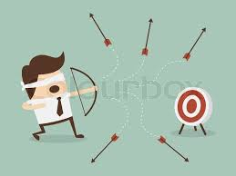
deliberate practice requires rapid feedback to refine performance
“Deliberate Practice also involves the provision of immediate feedback, time for problem-solving and evaluation, and opportunities for repeated performance to refine behavior.”

Slide 29
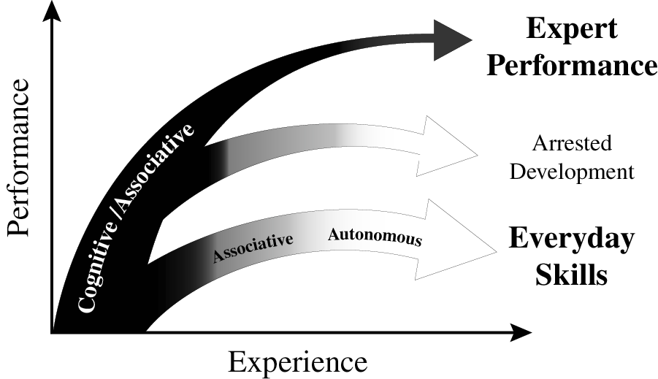
experience & variety of outcomes
Ericsson K. Anders. (2013). "The science of human excellence meets psychotherapy.” lecture at “Achieving clinical excellence conference.” May 17th, Amsterdam.

Slide 30

musicians & deliberate practice
classic early study on 20 yr old
violin students at the renowned
Music Academy of West Berlin
painstaking series of interviews
students sorted into 3 groups by professors’ assessments and success in open competitions
groups indistinguishable by average age of starting violin (age 8), average age at which decided to become musicians (just before age 15), number of teachers, etc. etc.
what stood out dramatically were the differences in hours spent practising – with no exceptions!
Ericsson, K. A., Krampe, R. T. & Tesch-Romer, C. (1993). “The role of deliberate practice in the acquisition of expert performance." Psychol Review 100(3): 363-406.

Slide 31
maintaining expertise
"If I don't practice one day, I know it; two days, the critics know it; three days, the public knows it.“ Jascha Heifetz
Krampe, R. T. and K. A. Ericsson (1996). "Maintaining excellence: Deliberate practice and elite performance in young and older pianists." J Exp Psychol Gen 125(4): 331-359. Two studies investigated the role of deliberate practice in the maintenance of cognitive-motor skills in expert and accomplished amateur pianists. Older expert and amateur pianists showed the normal pattern of large age-related reductions in standard measures of general processing speed. Performance on music-related tasks showed similar age-graded decline for amateur pianists but not for expert pianists, whose average performance level was only slightly below that of young expert pianists. The degree of maintenance of relevant pianistic skills for older expert pianists was predicted by the amount of deliberate practice during later adulthood. The role of delib-erate practice in the active maintenance of superior domain-specific performance in spite of general age-related decline is discussed.

Slide 32
psychotherapy/deliberate practice
17 therapists & 1,632 clients were studied – therapists were classified into four quartiles depending on their effectiveness.
as expected – qualifications, profession, experience, age, and gender were found to be unrelated to effectiveness.
fascinatingly, when asked about their use of client feedback, more successful therapists were much more likely to report being “surprised” by it – possibly a measure both of how well they had “set up” the feedback & of their openness/receptivity
also significant was their answer to the question: “How many hours per week (on average) do you spend alone seriously engaging in activities related to improving your therapy skills in the current year?” – the quartiles answered on average 7.39 (1st quartile); 4.13 (2nd); 2.00 (3rd) & 0.50 hours (4th quartile).
Chow, D. L., et al. (2015). "The role of deliberate practice in the development of highly effective psychotherapists." Psychotherapy (Chic) 52(3): 337-345.

Slide 33
psychotherapy/deliberate practice
“solitary activities” included ”reviewing therapy recordings alone, reviewing difficult/challenging cases alone, mentally running through & reflecting on past sessions in one’s mind, mentally running through & reflecting on what to do in future sessions, writing down reflections of past sessions, writing down plans for future sessions, viewing master therapist videos with the aim of developing specific therapeutic skills as a therapist, reading case examples (e.g. narratives, transcripts, case studies), reading of journals pertaining to psychotherapy & counselling, reading/re-reading of core counselling & therapeutic skills in psychotherapy.”
Chow, D. L., et al. (2015). "The role of deliberate practice in the development of highly effective psychotherapists." Psychotherapy (Chic) 52(3): 337-345.

Slide 34
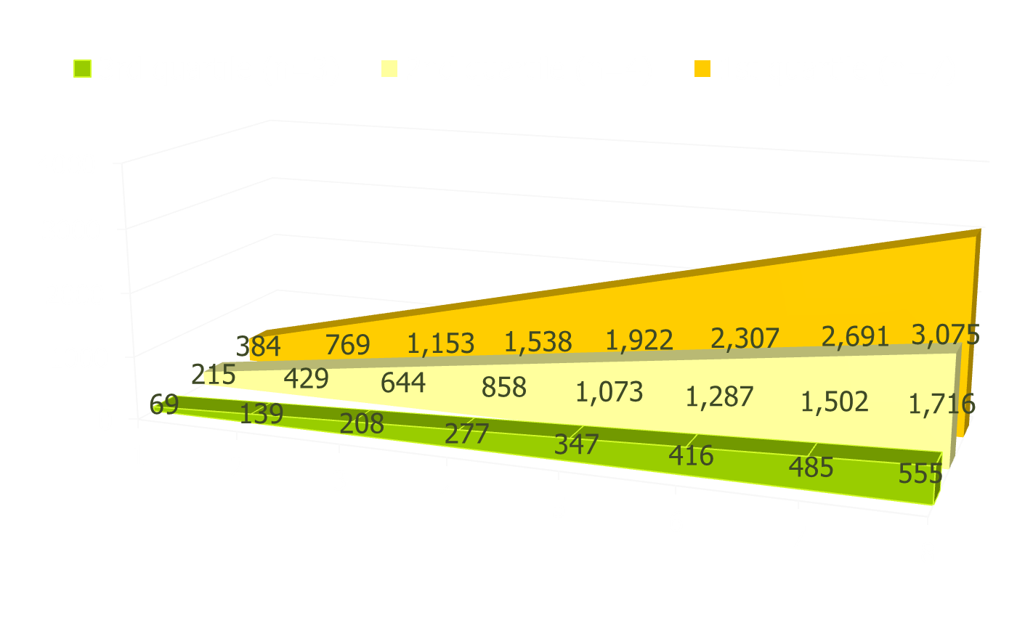
psychotherapy/deliberate practice
cumulative time spent in solitary practice over the first eight years of work as a psychotherapist

Slide 35
design & sequencing of training
ideally one monitors current performance & then designs specific individualized training activities: there is relevance here both for psychotherapists & clients.
Ericsson K. Anders. (2013). "The science of human excellence meets psychotherapy.” lecture at “Achieving clinical excellence conference.” May 17th, Amsterdam.

Slide 36
developing expertise research
clarify overall starting point and overall goal – an obvious example is an aim to improve the proportion of clients who get to “recovery”.
choose an important sub-goal that will be a good building block in reaching the overall goal.
again clarify one’s starting point and what the targeted sub-goal end state will look like.
deliberate practice of sub-goal building block
fast, accurate feedback, the challenge repeated many times, gradual incremental progress
select further building block sub-goals to work on
monitor progress to main over-arching goal
… badminton example!

Slide 37
general orientation
work & S-DT needs – satisfaction & frustration both important
work-life balance – within three hours
VIA strengths use & job selection/crafting
Anders Ericsson’s ‘deliberate practice’

