Slide 1
session 7 – key points
relationships are central for health & wellbeing
funeral speeches – goals for relationship roles
robin dunbar’s research & personal social networks
how are we doing & s-dt needs for relatedness
emotional intelligence, closeness, the affect dyad

Slide 2
course outline/our journey
values, self-determination
mindset, exercise & sleep
willpower, diet, dependencies
mindbus & coping responses
savouring & gratitude
work, strengths, expertise
roles, dunbar, needs, dyads
nourishing, conflict, wisdom
groups, weak ties, resonance
review & stepping forward

Slide 3
general orientation
work & S-DT needs – satisfaction & frustration both important
work-life balance – within three hours
VIA strengths use & job selection/crafting
Anders Ericsson’s ‘deliberate practice’

Slide 4
work & s-dt needs satisfaction
“… all four satisfactions are significantly and independently associated with meaningful work.”
“ … the fulfilment of basic psycho-logical needs in the workplace is related to higher job satisfaction and … is associated with higher personal wellbeing & fewer health problems.”
how do you score on the work need satisfaction scale & any implications?
Martela, F. and T. J. J. Riekki (2018). "Autonomy, competence, relatedness, and beneficence: A multicultural comparison of the four pathways to meaningful work." Frontiers in Psychol 9(1157).
Gomez-Baya, D. and A. M. Lucia-Casademunt (2018). "A self-determination theory approach to health and well-being in the workplace.” J Appl Soc Psychol 48(5): 269-283.

Slide 5

work-life balance?
how many hours a week are you working at your job?
how many hours a week would you like to be working at your job?
3 hour or more difference weekly is associated with less life satisfaction
how do you score and is there anything it might be helpful to do about your current situation?
Headey, B. and R. Muffels (2018). "A theory of life satisfaction dynamics: stability, change and volatility in 25-year life trajectories in Germany." Social Indicators Research 140(2): 837-866.

Slide 6
use of via (signature) strengths in job selection and job crafting
what are your ‘signature’ strengths (check with grid exercise)?
how much do you use these top strengths in your work – it may be worth charting on the weekly record
how could you increase your use of these strengths in your working life – job crafting & job selection?
www.viacharacter.org
Schutte, N. S. and J. M. Malouff (2019). "The Impact of Signature Character Strengths Interventions: A Meta-analysis.” Journal of Happiness Studies 20(4): 1179-1196.
Ghielen, S. T. S., et al. (2018). The Journa"Promoting positive outcomes through strengths interventions: A literature review.”l of Positive Psychology 13(6): 573-585.

Slide 7
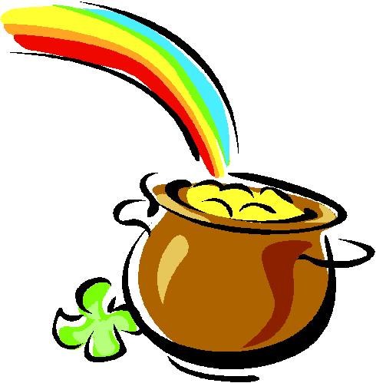
ericsson & achieving excellence
Ericsson, K. A. (2017). "Expertise and individual differences: the search for the structure and acquisition of experts' superior performance.” Wiley Interdiscip Rev Cogn Sci 8(1-2).
Ericsson, K. A. (2015). "Acquisition and maintenance of medical expertise: a perspective from the expert-performance approach with deliberate practice." Acad Med 90(11): 1471-1486.
Hashimoto, D. A., et al. (2015). "Deliberate practice enhances quality of laparoscopic surgical performance in a randomized controlled trial: from arrested development to expert performance." Surg Endosc 29(11): 3154-3162.
Ericsson, K. A. (2013) “The science of excellence meets psychotherapy.” lecture at “Achieving clinical excellence conference” , May 17th, Amsterdam.
Ericsson, K. A., K. Nandagopal, et al. (2009). "Toward a science of exceptional achievement: Attaining superior performance through deliberate practice." Ann N Y Acad Sci 1172:199-217.
Ericsson, K. A. (2008). "Deliberate practice and acquisition of expert performance: A general overview." Acad Emerg Med 15(11): 988-994.
Ericsson, K. A., J. t. Whyte, et al. (2007). "Expert performance in nursing: Reviewing research on expertise in nursing within the framework of the expert-performance approach.“ ANS Adv Nurs Sci 30(1): E58-71.
Ericsson, K. A., M. J. Prietula, et al. (2007). "The making of an expert." Harv Bus Rev 85(7-8): 114-121, 193.
Ericsson, K. A. (2007). "An expert-performance perspective of research on medical expertise: The study of clinical performance." Med Educ 41(12): 1124-1130.
Notes:
Benor in his 1990 survey states that a he identified 131 controlled trials of spiritual healing in English of which 56 showed statistically significant results at p<.01 or better and another 10 at p<.02-.05. The studies involved healing effects on enzymes, cells, yeasts, bacteria, plants, animals and man.
The study published in Holistic Medicine describes the fascinating work on anaesthetized mice which amongst other things showed a “linger effect”.

Slide 8
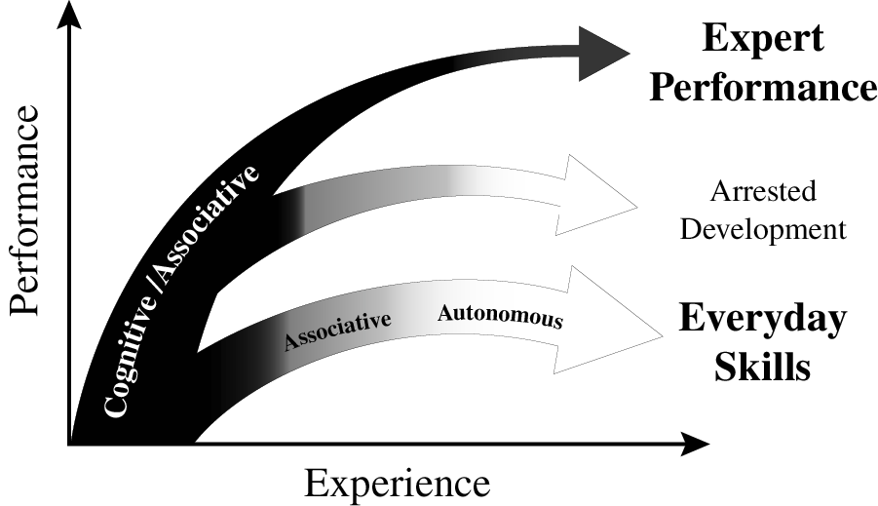
experience & variety of outcomes
Ericsson K. Anders. (2013). "The science of human excellence meets psychotherapy.” lecture at “Achieving clinical excellence conference.” May 17th, Amsterdam.

Slide 9
course outline/our journey
values, self-determination
mindset, exercise & sleep
willpower, diet, dependencies
mindbus & coping responses
savouring & gratitude
work, strengths, expertise
roles, dunbar, needs, dyads
nourishing, conflict, wisdom
groups, weak ties, resonance
review & stepping forward

Slide 10
session 7 – key points
relationships are central for health & wellbeing
funeral speeches – goals for relationship roles
robin dunbar’s research & personal social networks
how are we doing & s-dt needs for relatedness
emotional intelligence, closeness, the affect dyad

Slide 11
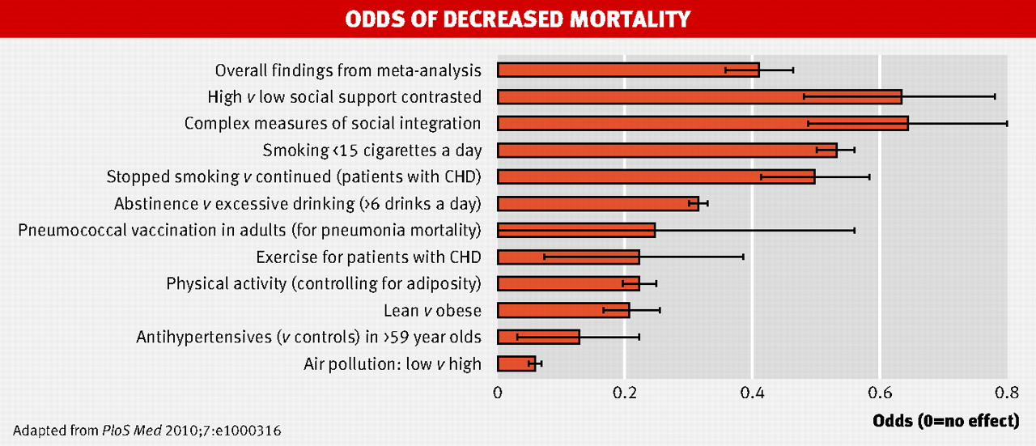
strong relationships improve survival as much as quitting smoking
.
Holt-Lunstad, J., et al. (2010). "Social relationships and mortality risk: a meta-analytic review.” PLoS Medicine 7(7): e1000316.
Chart taken from (2010) “Strong relationships improve survival as much as quitting smoking” BMJ 341: bmj.c4339

Slide 12
the importance of personality

Slide 13
session 7 – key points
relationships are central for health & wellbeing
funeral speeches – goals for relationship roles
robin dunbar’s research & personal social networks
how are we doing & s-dt needs for relatedness
emotional intelligence, closeness, the affect dyad

Slide 14
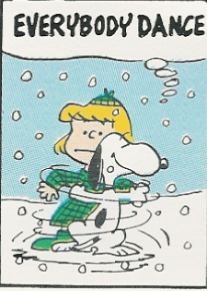
activity: how are we doing?
remembering the early exercise we did on ‘funeral speeches’, how are we doing in our key relationships roles?

Slide 15
session 7 – key points
relationships are central for health & wellbeing
funeral speeches – goals for relationship roles
robin dunbar’s research & personal social networks
how are we doing & s-dt needs for relatedness
emotional intelligence, closeness, the affect dyad

Slide 16
personal social networks
Dunbar, R. (1998). "The social brain hypothesis." Evolutionary Anthropology 6(5): 178–190.
Stiller, J. & R. I. M. Dunbar (2007). "Perspective-taking and memory capacity predict social network size." Social Networks 29(1): 93-104.
Powell, J. L., et al. (2010). "Orbital prefrontal cortex volume correlates with social cognitive competence." Neuropsychologia 48: 3554-3562.
Dunbar, R. I. M. (2014). "The social brain: psych-ological underpinnings and implications for the structure of organizations." Current Directions in Psychological Science 23(2): 109-114.
Roberts, S. B. & R. I. Dunbar (2015). "Managing relationship decay: network, gender, and contextual effects." Human Nature 26: 426-450.
Mac Carron, P., et al. (2016). "Calling Dunbar's numbers." Social Networks 47: 151-155.
particular thanks for the extensive research on social networks conducted by Robin Dunbar, Oxford professor of evolutionary psychology, & colleagues

Slide 17
support clique/closest relationships
the ‘support clique’ are the people who one would turn to in times of extreme social, emotional or financial distress – note too ‘broaden & build’
on average there are about 5 people in the ‘support clique’ – with a range from 0 to 15 and sometimes 1 or 2 who are especially close - there may be a trade-off between overall numbers & individual closeness
these very close relationships involve considerable ongoing commitment of time, energy & emotion, but they ‘repay’ with major benefits for physical health, emotional resilience & overall wellbeing
‘support clique’ relationships are typically characterised by high emotional closeness, trust & frequency of contact
10 =
intensely close/intimate
fascinatingly ‘support clique’ numbers are limited not only by available time but also by ‘mentalising ability’ (perspective –taking competence) & the associated size of one’s orbital prefrontal cortex
0 =
emotionally neutral

Slide 18
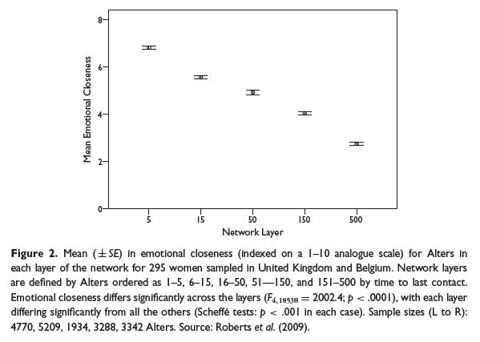
closeness varies by network layer
Sutcliffe, Dunbar et al, 2012

Slide 19
sympathy group/good relationships
on average – including those in the ‘support clique’ - there are roughly 15 people in the ‘sympathy group’ – they are not so deeply close as those who are also in the ‘clique’ and are probably seen about monthly rather than approximately weekly for the ‘clique’
the ‘sympathy group’ are described as people who would be ‘devastated’ by the death of someone else in the group
typically there are about 3 x as many people in the ‘sympathy group’ as in the ‘support clique’ – and in both there are usually a considerably higher proportion of same sex contacts; people from large families may not have much time/space left in their sympathy group for non-family friends
emotional closeness changes & it takes time & regular contact to maintain – this is especially true for non-family friendships
10 =
intensely close/intimate
although both ‘sympathy group’ & ‘support clique’ numbers are limited by available time – the size of the latter is also dependent on mentalising ability (perspective –taking competence), while the former possibly depends more on memory capacity
0 =
emotionally neutral

Slide 20
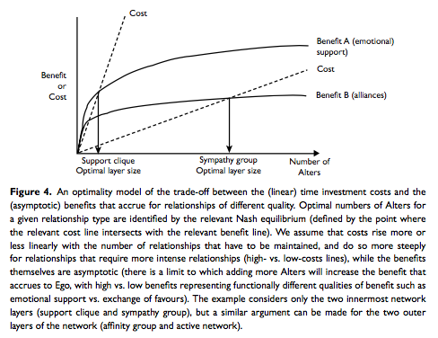
how spend our social time budget?
cross-cultural studies suggest a typical social time budget of ~3.5 hr per day
Sutcliffe, Dunbar et al, 2012

Slide 21
activity: identifying relationships
who would you currently put into your inner circle ‘support clique’? note whether they are kin (k), kin by couple relationship (ck) or non-related friend (f); local (l) or non-local (nl); how long known; and how emotionally close (e?)
the ‘support clique’ tend to be who you would turn to in a crisis & also you value your regular (at least weekly?) contact with them. in contrast you have contact with the ‘sympathy group’ maybe only monthly & they are also less close

Slide 22
session 7 – key points
relationships are central for health & wellbeing
funeral speeches – goals for relationship roles
robin dunbar’s research & personal social networks
how are we doing & s-dt needs for relatedness
emotional intelligence, closeness, the affect dyad

Slide 23
three (+one) key psychological needs
autonomy – personal choice not compulsion by outside forces
competence – capable & effective not incompetent & inefficient
relatedness – regular emotional intimacy & shared activities not isolation & loneliness
beneficence – benevolence, being able to give not just self-centred
autonomy
competence
relatedness
beneficence
Reis, H. T., K. M. Sheldon, et al. (2000). Daily well-being: the role of autonomy, competence, and relatedness. Pers Soc Psychol Bull 26(4): 419-435. Sheldon, K. M., A. J. Elliot, et al. (2001). What is satisfying about satisfying events? Testing 10 candidate psychological needs. J Pers Soc Psychol 80(2): 325-39.

Slide 24
session 7 – key points
relationships are central for health & wellbeing
funeral speeches – goals for relationship roles
robin dunbar’s research & personal social networks
how are we doing & s-dt needs for relatedness
emotional intelligence, closeness, the affect dyad

Slide 25
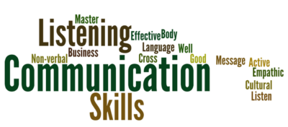
helpful communication central too
comfortable talking about my feelings
frequently encourage to express their views
always try to be honest
often ask for feedback
know how to describe my feelings accurately
praise & encourage far more often than criticize
try to make time for friendly conversation

Slide 26
meeting deeply
it’s likely to be most helpful if this communication is held in a setting of goodwill for oneself & for the other person
expressivity
receptivity
to deepen communication it can be useful to be aware of any blocks in the four phases highlighted in this diagram and fifthly to monitor the overall quality of goodwill
meeting
deeply
note too the possible
value of tracking five aspects of emotion – the trigger, body response, impulse, verbal label & associated wish or need
after Bugental,
Greenberg & Cooper
receptivity
expressivity

Slide 27
session 7 – key points
relationships are central for health & wellbeing
funeral speeches – goals for relationship roles
robin dunbar’s research & personal social networks
how are we doing & s-dt needs for relatedness
emotional intelligence, closeness, the affect dyad

Slide 28
affinity groups & active networks
on average there are about 150 people in a personal full ‘active network’ – with a natural range of approximately 100-250; it correlates with pre-industrial village size & earlier tribal size; the active network may well serve both territorial & mate-access functions
one’s full ‘active network’ is made up mostly of ‘acquaintances’ - all the people with whom one has a ‘personalized’ relationship and who one wants to maintain contact with
successive network layers increase in numbers by a factor of about 3, and tend to involve relationships that demand less time investment to maintain & that are less emotionally close – however different layers respond to different needs
the smaller – approximately 50 sized – affinity or foraging group probably primarily has an anti-predation function
10 =
intensely close/intimate
social identity theory (haslam, cruwys, et al) highlights the considerable health gains obtainable through identification & participation with a variety of groups, that may be populated by acquaintances rather than friends
0 =
emotionally neutral

Slide 29
metaphors & mechanisms
mountain: - 5, 15, 50, 150 -
food: well balanced ‘diet’
garden: regular ‘watering’
music: how play together
attachment mentalising memory
mu-opioids orbital pfc capacity

Slide 30
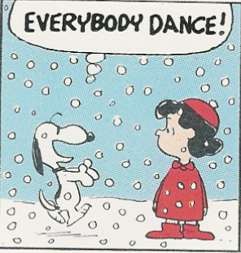
activity 4: social time budget
relationships are a bit like food – we want good, well-balanced diets
our relationship networks are also gardens needing regular watering
and like mountains – are the layers a (1-2)/5/15/50/150 pattern?
typical ‘social time budgets’ are about 3½ hours per day – how is yours? is it too big or too small?
how do you allocate your ‘budget’ to the different layers of your network? is this a good spread?
how’s the ‘music’ – is the quality of the time you spend good?

